Slide 1
Being agile with modern Java

Slide 2
Being agile?

Slide 3
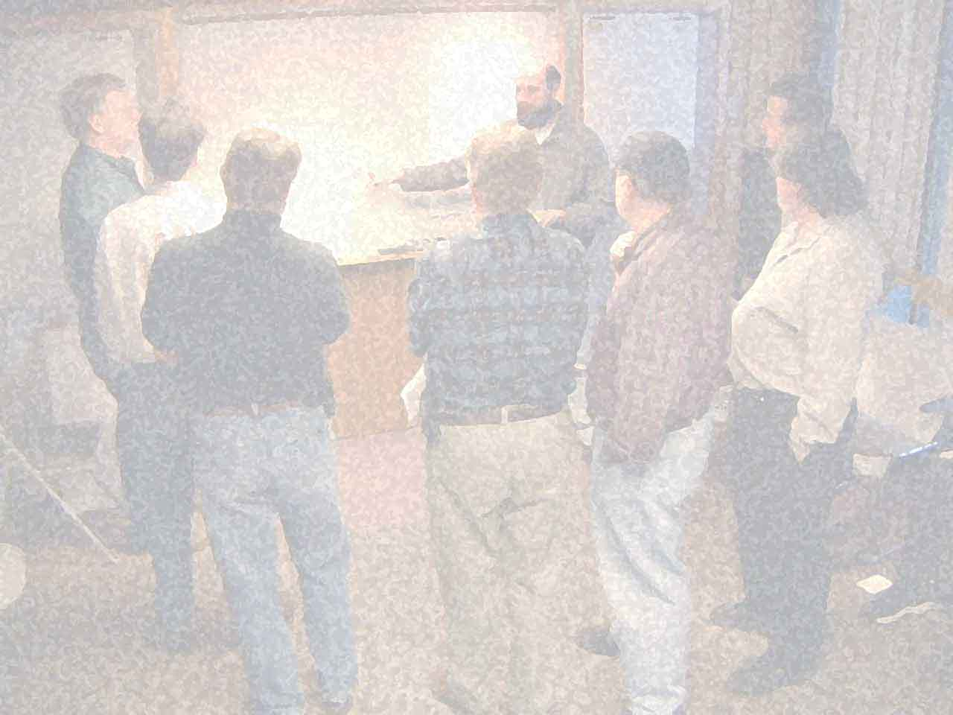

Slide 4
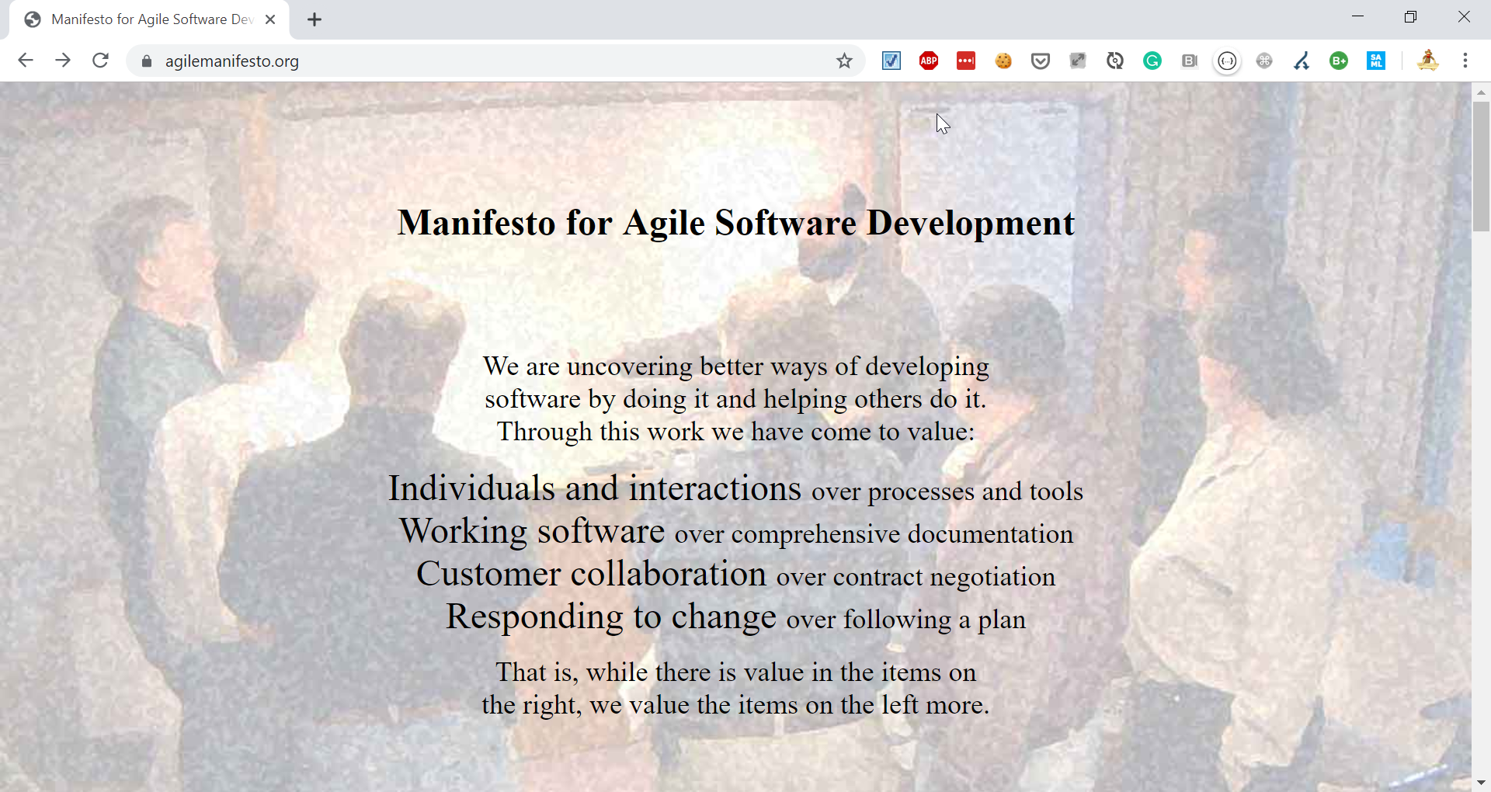

Slide 5

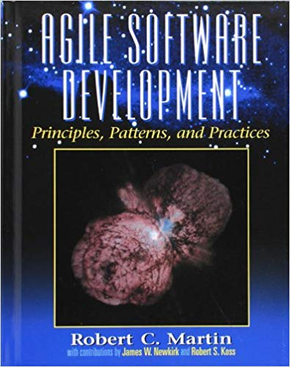

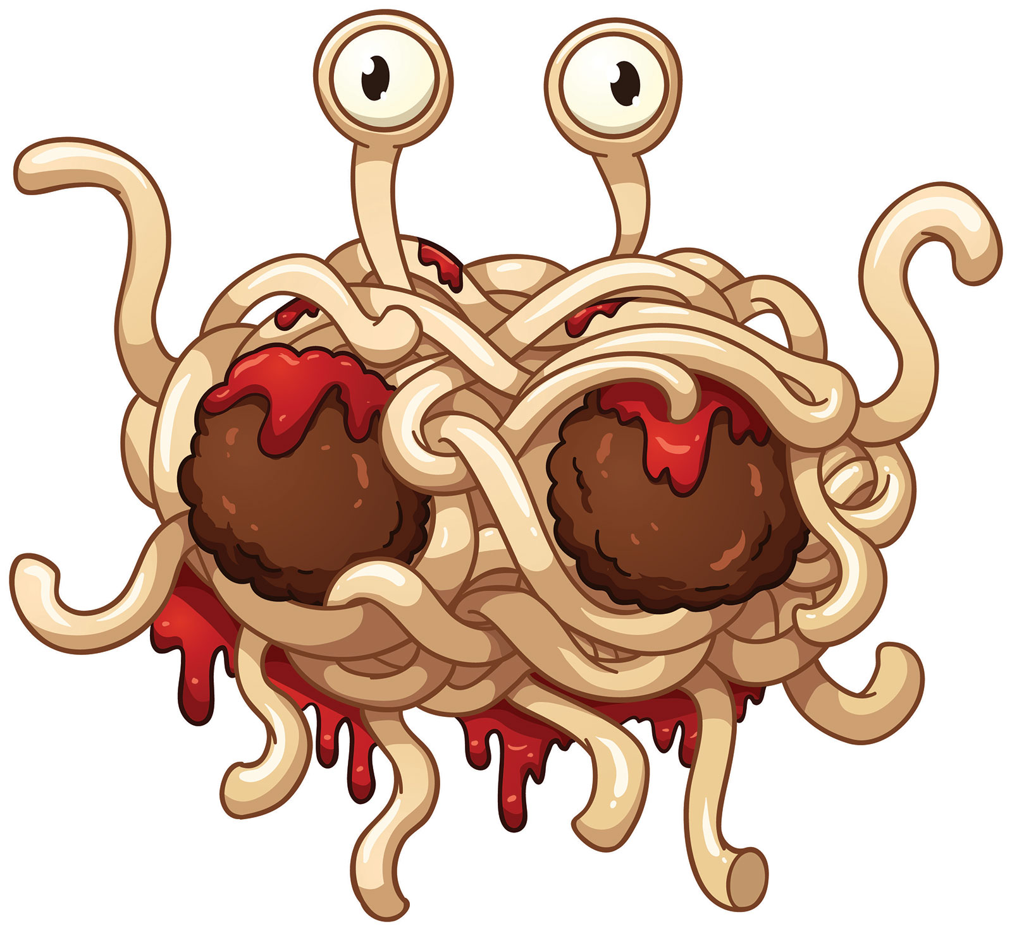

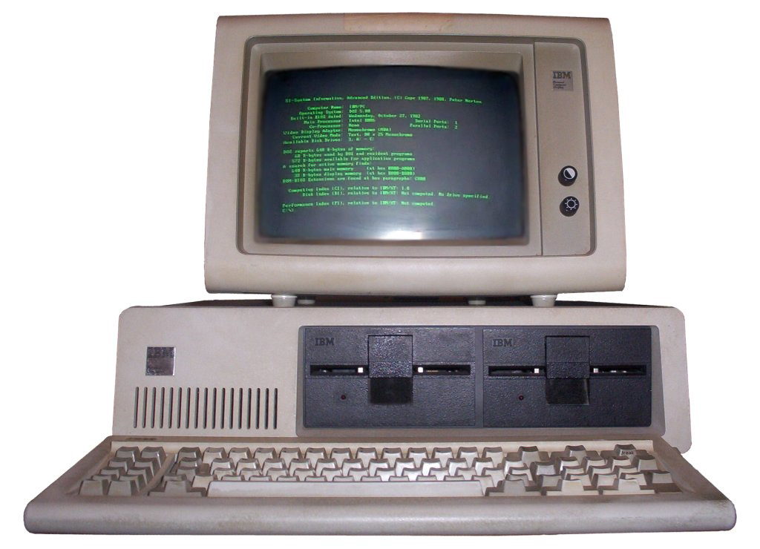
(at that time…)
PROBLEMS

Slide 6
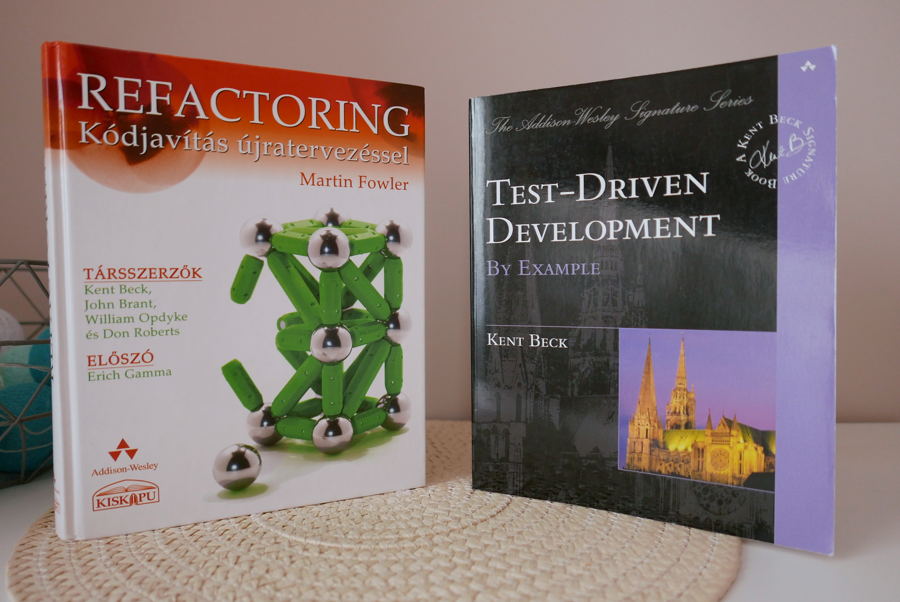

Slide 7
Being agile?

Slide 8
Thinking agile?

Slide 9
KANBAN
VS
SCRUM

Slide 10
continuous optimization
simplification
small iterations
small experiments
AGILE
baby steps
stabilization
Notes:
EXAMPLE: Refactoring & TDD are using these approaches

Slide 11
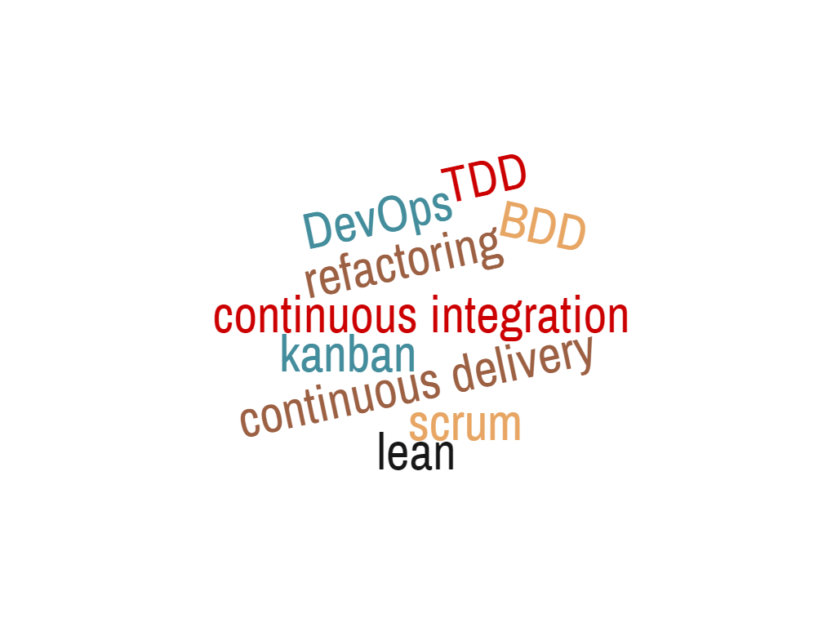
SAME APPROACH
Notes:
Word Cloud:
1 continuous~integration
1 continuous~delivery
1 refactoring
1 kanban
1 DevOps
1 scrum
1 lean
1 TDD
1 BDD

Slide 12
CI

Slide 13
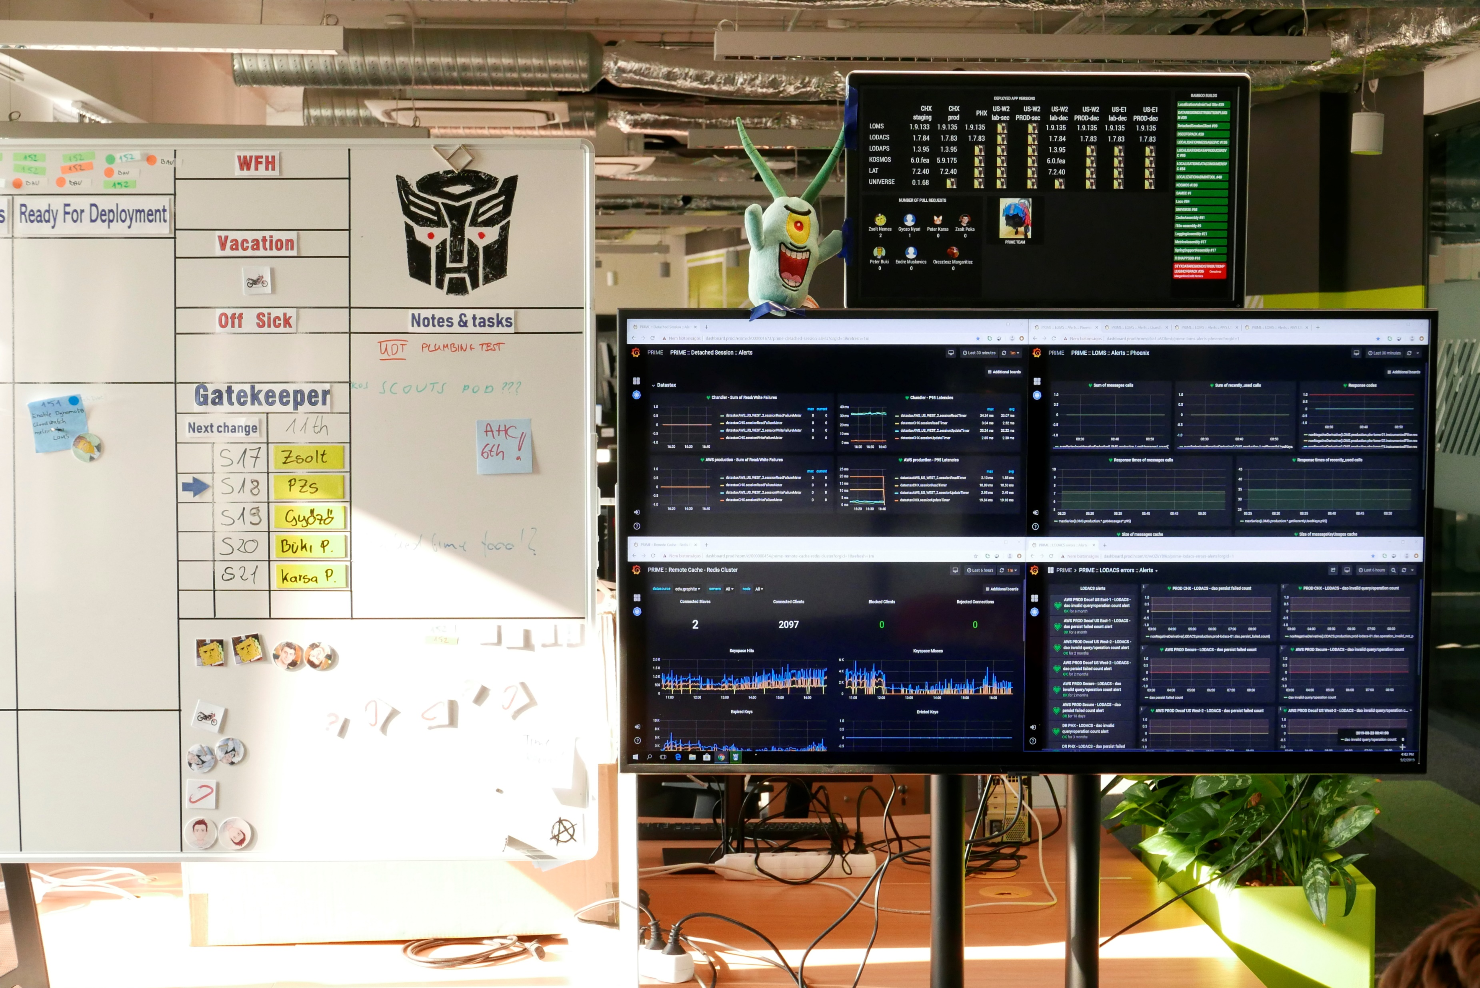
CI

